Slide 1

A brief history of computer science and computers
Skills we practice:
Speaking
Reading
Listening

Slide 2
SPEAKING
1. How would you define the term computer science?
2. What are the main objectives of computing as science?
3. In your view, is computer science predominantly a mathematical, engineering or scientific discipline?
4. What do you know about the history of computer science? When did it start and how did it evolve?
5. What do you know about the major milestones in the evolution of this science?

Slide 3
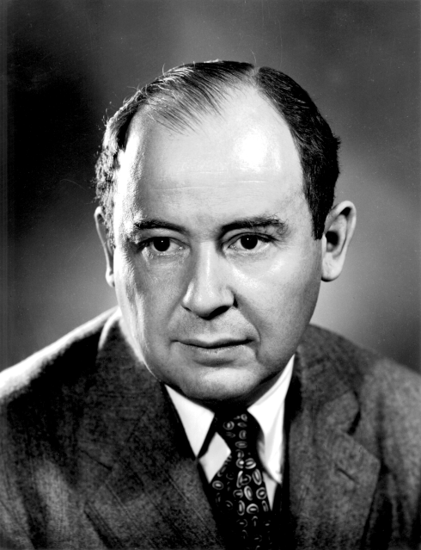
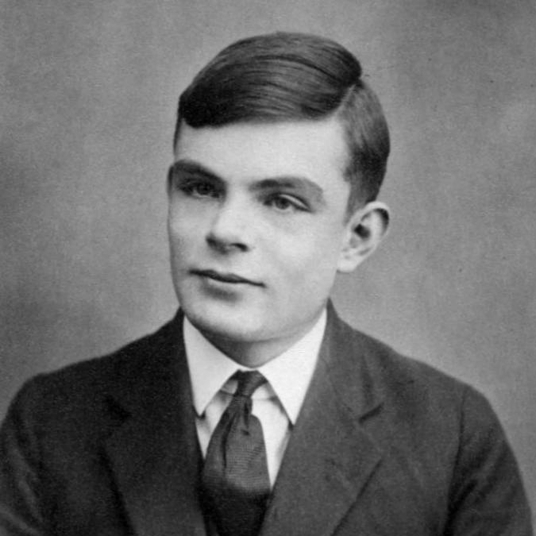
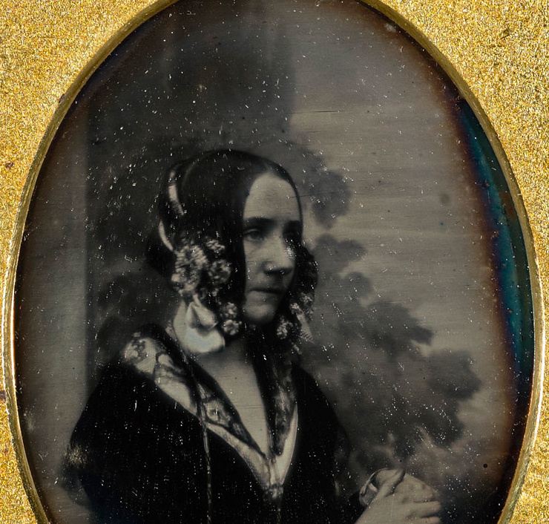
Work in pairs
John von Neumann
Discuss about the three people and their contribution to the field of computer science.
Alan Turing
Ada Lovelace

Slide 4
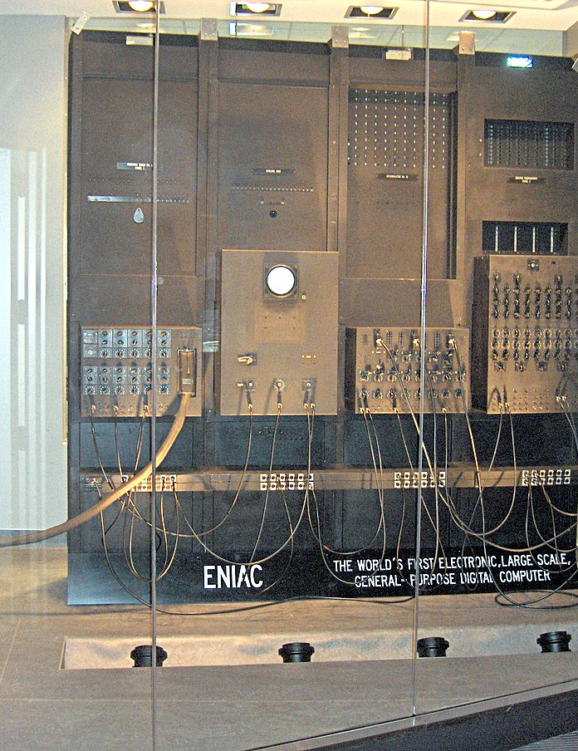
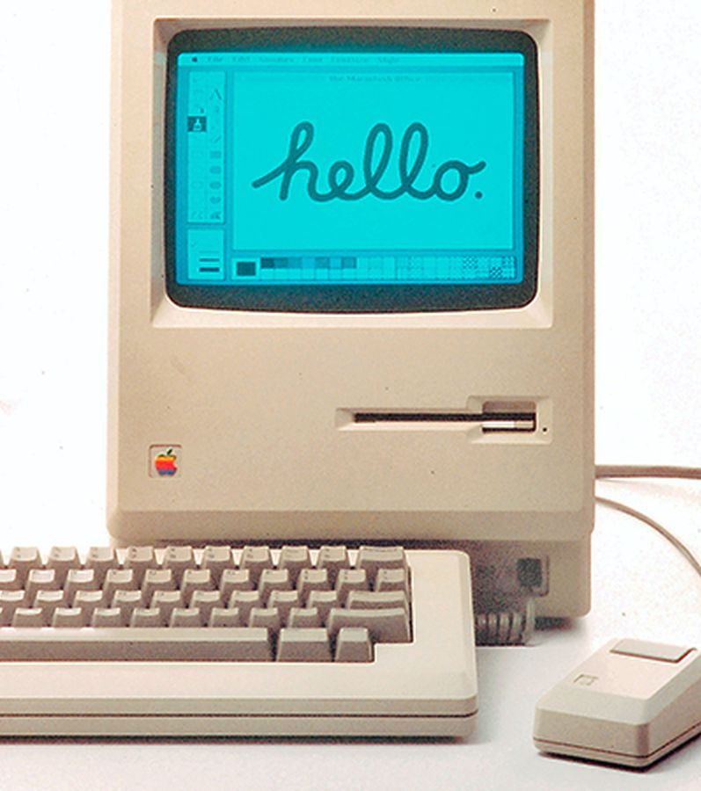

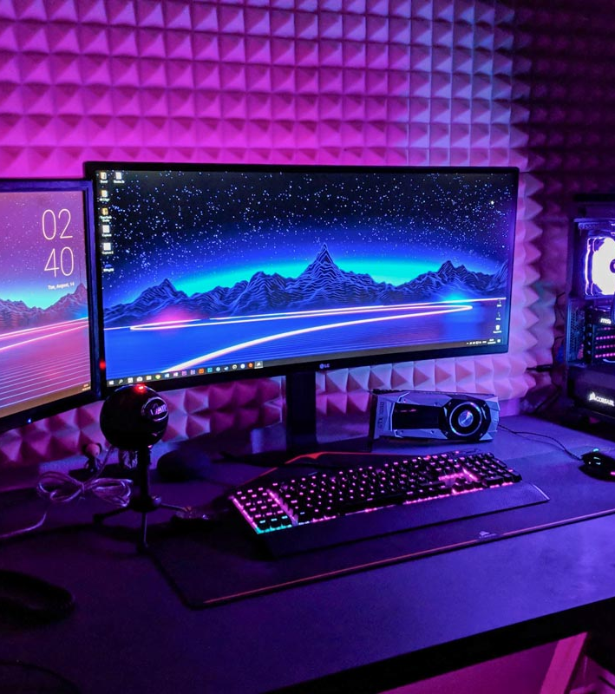
.
Why do you think computers evolved this way?

Slide 5
Here are a few important events in the history of computer science. Try to guess in which order these events took place, then read the text to check.
Computing is called “information processing”.
Computing masters algorithms, data structures, numerical methods, programming languages, operating systems, databases, graphics, artificial intelligence and software engineering.
Universities start offering computer science programmes.
The adoption of the High Performance Computing and Communications Act (HPCA) act by the U.S., which led to the creation of the National Information Infrastructure.
The US and the UK commission projects to build the first digital computers.
The term computing is taken as standard to refer to the core disciplines of computer science, information processing, software engineering etc.
Kurt Gödel, Alonzi Church, Emil Post and Alan Turin’s papers are written.

Slide 6
READING Read the text and check your answers.
1
Computing is integral for science, not just a tool for analysing data, but as an agent of thought and discovery. It has not always been this way. Computing is a relatively young discipline. It started as an academic field of study in the 1930s with a cluster of remarkable papers by Kurt Gödel, Alonzi Church, Emil Post and Alan Turing. The papers laid the mathematical foundations that would answer the question “what is computation?” and discussed schemes for its implementation.

Slide 7
.
2
At the time that these papers were written, the terms “computation” and “computers” were already in common use, but with different connotations from today. Computation was taken to mean the mechanical steps followed to evaluate mathematical functions; computers were people who did computations. In recognition of the social changes they were ushering in, the designers of the first digital computer projects all named their systems with acronyms ending in “-AC”, meaning automatic computer - resulting in names such as ENIAC, UNIVAC and EDSAC.
At the start of the World War II, the militaries of the United States and the United Kingdom became interested in applying computation to the calculation of ballistic and navigation tables and to the cracking of ciphers. They commissioned a project to build electronic digital computers. Only one of the projects was completed before the war was over. That was the top-secret project at Bletchley Park in England, which cracked the German Enigma cipher using methods designed by Alan Turing.

Slide 8
.
During its youth, computing was an enigma to the established fields of science and engineering. At first, computing looked like only the applied technology of mathematics, electrical engineering or science, depending on the observer. However, over the years, computing provided a seemingly unending stream of new insights and it defied many early predictions by resisting absorption back into the fields of its roots. By 1980, computing had mastered algorithms, data structures, numerical methods, programming languages, operating systems, networks, databases, graphics, artificial intelligence and software engineering. Its great technological achievements - the chip, the personal computer and the internet - brought it into many lives. These advances simulated more subfields, including network science, Web science, mobile computing, enterprise computing, cooperative work, cyberspace protection, user-interface design and information virtualisation. The resulting commercial applications have spawned new research challenges in social networks, endlessly evolving computation, music, video games, user-generated content and much more.
The name of the field has changed several times to keep up with the flux. In the 1940s, it was called automatic computation and in the 1950s, information processing. In the 1960s, as it moved into academia, it acquired the name computer science in the US and informatics in Europe. By the 1980s computing comprised a complex of related fields, including computer science, informatics, computational science, computer engineering, software engineering, information systems and information technology. By 1990 the term computing had become the standard for referring to this core group of disciplines.
3

Slide 9
.
The founders of the field came from all three paradigms. Some thought computing was a branch of applied mathematics, some a branch of electrical engineering, and some a branch of computational-oriented science. During its first four decades, the field focused primarily on engineering: the challenges of building computers, networks and complex software were daunting and occupied almost everyone’s attention. By the 1980s, these challenges had largely been met and computing was spreading rapidly into all fields, with the help of networks, supercomputers and personal computers.
During the 1980s computers became powerful enough that science visionaries could see how to use them to tackle the hardest questions – the “grand challenge” problems in science and engineering. The resulting “computational science” movement involved scientists from all countries and culminated in the U.S. Congress’ adoption of the High-Performance Computing and Communications (HPCC) Act of 1991 to support research on a host of large problems.
Today there is an agreement that computing exemplifies science and engineering, and that neither science nor engineering characterizes computing. Then what does? What is computing’s paradigm?
4

Slide 10
.
The second wave focused on programming, the art of designing algorithms that produce information processes. In the early 1970s, computing pioneers Edsger Dijkstra and Donald Knuth took strong stands favouring algorithm analysis as the unifying theme. A catchphrase of this wave was “computer science equals programming.” In recent times, this view has foundered because the field has expanded well beyond programming, whereas the public understanding of a programmer has narrowed to just those who write code.
The third wave came as a result of the Computer Science and Engineering Research Study (COSERS), led by Bruce Arden in the late 1970s. Its catchphrase was “computing is the automation of information processes.” Although its final report successfully exposed the science in computing and explained many esoteric aspects of the layperson, its central view did not catch on.
5

Slide 11
.
6
Computing as a field has come to exemplify good science as well as engineering. The science is essential to the advancement of the field because many systems are so complex that experimental methods are the only way to make discoveries and understand limits. Computing is now seen as a broad field that studies information processes, natural and artificial.
Adapted from: DENNING, J. Peter. The Great Principles of Computing

Slide 12
LISTENING
Ann believes that computer science is basically...
data analytics
problem solving
non-profit work
Emily is convinced that computer science gives people...
a lot of prospects.
a lot of problem-solving.
a lot of perspectives on problem-solving.

Slide 13
.
Bella thinks that...
her company has given her a lot of projects.
her company has been great to her.
her company could have allowed her to work more flexible hours because she has a baby.
Zavain thinks
it's very easy to start coding without knowing the solution of the problem.
that it's easy to code being blind.
that it's exponentially useful not to take any steps back in coding.

Slide 14
.
Justin fell in love with his profession after writing codes for
programs of virtual reality.
mobile applications.
small games.
Brina says that
everyone has started learning coding.
computers have become the main communication tool of today.
computers have become the quickest way to communicate.

Slide 15
VOCABULARY Match the adjectives to the pairs of nouns to form collocations.
1 technological
2 automated
3 new age
4 scientific
5 high-tech
6 experimental
7 space
8 digital
a inquiry / journal
b stage / research
c warfare / era
d factory / appliances
e video discs / camera
f exploration / station
g philosophy / travellers
h gadgetry / industry

Slide 16
Use the collocations from the previous exercise to complete the sentences.
1 The following decades saw numerous normative arguments on the role of empirical and _______________________________ in computing.
2 Professor Smith has recently had his findings published in a prominent _______________________________.
3 This is the product prototype, as you can see, it is still at the _______________________________.
4 _______________________________ has put an end to the use of conventional weapons and traditional battle strategies.
5 Supposedly, _______________________________, or DVDs as they are called, are far more resistant to scratching than records.
6 People looking for meaning in today’s confusing modern world often immerse themselves in _______________________________.
7 Living in the _______________________________ makes it easy to forget how far we’ve come in the past twenty years.
8 The modern household needs to accommodate a wide range of _______________________________ from integrated multi-room entertainment systems to state of the art security systems and much in between.
experimental reserach
scientific journal
experimental stage
Technological warfare
digital video discs
new age philosophy
automated era
high-tech gadgetry

Slide 17
WRITING Think of an important person in the field of computing. Using your prior knowledge and the Internet, make some brief notes about the person.
Brief biographical details
Achievements / Early career
His / Her main achievement

Slide 18

Thank you!

